Slide 1
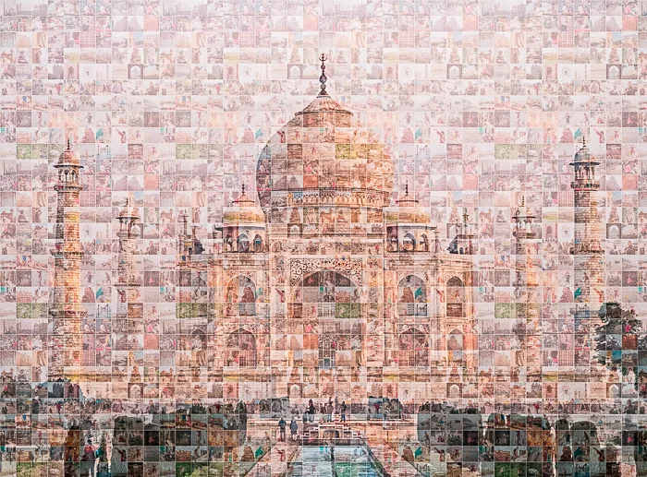
Photo-mosaic Generator
Presented by-
Vinayak Bhosle 205
Aniket Yadav 170
Aditya Faye 129
Himanshu Sengar 221

Slide 2
Abstract
A photographic mosaic, also known under the term Photomosaic, is a picture that has been divided into (usually equal sized) tiled sections, each of which is replaced with another photograph that matches the target photo.
We are using the function average_color for mapping each dataset image’s avg color to its corresponding rgb value.
Here we are dividing original image to grid of tiles, then making the original image as a collection 50x50 tiles.

Slide 3

Objectives
To create cache of dataset (pairing rgb values to dataset image)
To divide i/p image into tiles
Mapping tiles to relevant dataset image
Generating a photomosaic of input image (using dataset images)
Scopes
Basic map substitutes (place or road names ).
Advertising and broadcasting
Encoding decoding of an image for a long range data transfer

Slide 4
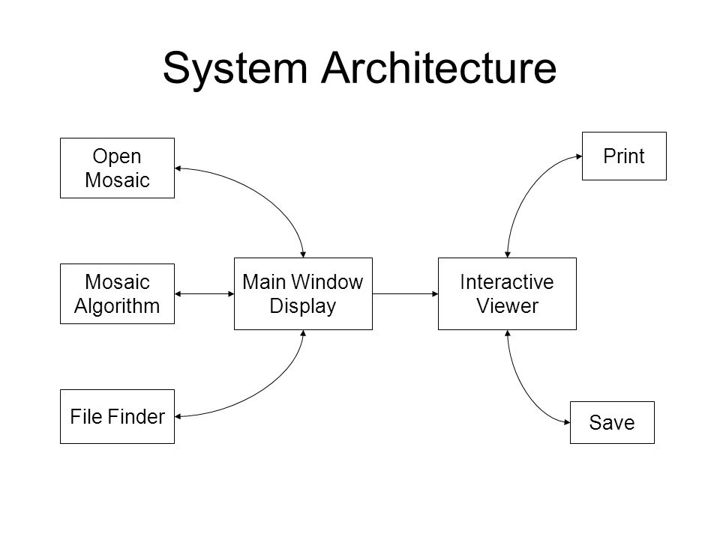
System Architecture

Slide 5
Methodology
Mapping avg color of image in dataset with its corresponding rgb value
Creating cache.json file of dataset
Selecting input image and marking up the grid lines
Calculating avg color of one tile at a time
Determining closest tile color with rgb value in cache.json
Randomly picking an image for the accepted rgb value via mapping
Creating a new output image file and adding previously picked image into its corresponding grid
Iterating above steps till we get a full mosaic of input image

Slide 6
Functions used
(Built-in) get_average_color
np.average
np.around
(Built-in) get_closest_color
eval
math.sqrt
Others
1. cv2.imread
2. cv2.imwrite
3. random.choice

Slide 7
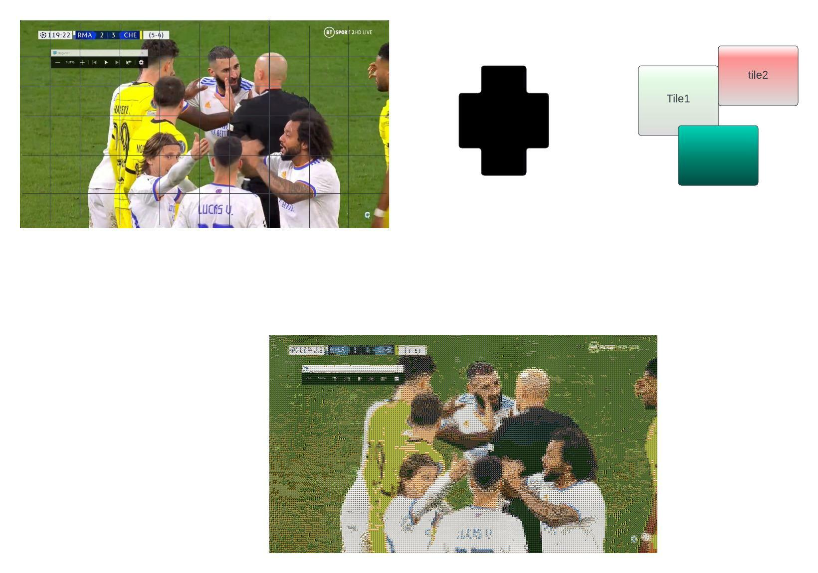
Result

Slide 8
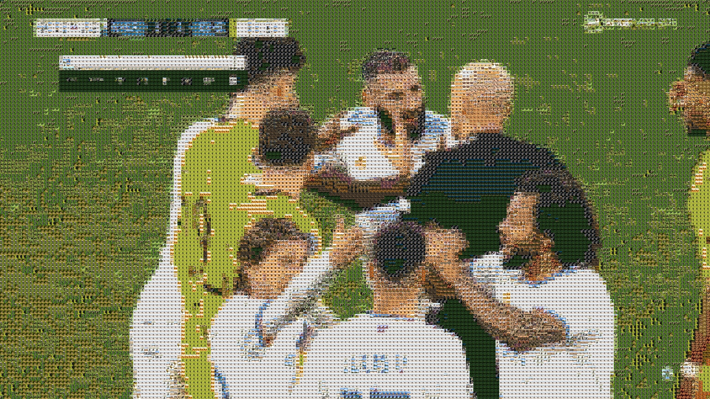

Slide 9
Conclusion
We were able to generate complete mosaic image using cache of 90 different animal dataset. We used tiles of size 10*10 then combined them to make a newly generator output image looking approximately as the input image.
Encoding & decoding of the image file can be implemented by encrypting the cache file.

